Slide 1
Network Security
Lab 2
Rehab Hosny

Slide 2
Caeser Cipher
If key = 3, Replaces each letter by 3rd letter.

Slide 3

Caeser Cipher (Cont.)
Or use mathematic operation:
Encryption:
cipherText= (plaintext + key) mod 26
Decryption:
plaintext= (ciphertext - key) mod 26

Slide 4
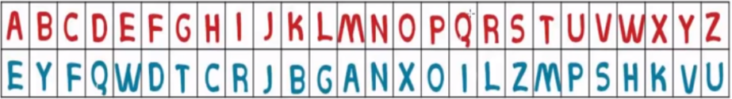
Monoalphabetic Cipher
each plaintext letter maps to a different random ciphertext letter
Example: encrypt “Hello” using Monoalphabetic
Ciphertext= cwggx

Slide 5
Hill Cipher
In order to encrypt a message using the Hill cipher, the sender and receiver must first agree upon a key matrix of size n x n.
In the following example key matrix is a 2 x 2 matrix and the message will be enciphered in blocks of 2 characters.

Slide 6
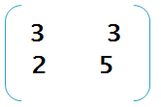
Hill Cipher (Example)
Plaintext: HEAD
key =

Slide 7


Hill Cipher (solution) encryption
Ciphertext = key * plaintext
E (HE) = * * =
E(HE) = mod 26 = = HI
33
34
33
34
7
8

Slide 8

Hill Cipher (solution) encryption
E (AD) = * * = = JP
Then ciphertext = HIJP
9
15

Slide 9
Hill Cipher (solution) decryption
Plaintext= invers( Key) * ciphertext
Solution:
1- calculate determinated value
2- find value multiplied by determinated value to obtain mod of this value is equal 1.
3- calculate invers of key matrix mod 26
4- multiply results from step 2 by result from3.

Slide 10
1- calculate determinated value
= (3*5)- (3* 2)= 9
2- find value multiplied by determinated value to obtain mod of this value is equal 1.
( 9* 3 ) mod 26= 1

Slide 11
3- calculate mod of invers of key matrix mod 26
Inverse of =
mod 26=
5 -3
-2 3
5 -3
-2 3
5 23
24 3

Slide 12
4- multiply results from step 2 by result from 3.
3* mod 26 = mod 26
= this is invers(Key)
5 23
24 3
15 69
72 9
15 17
20 9

Slide 13
Solution (Cont.)
Plaintext = inverse (key) * ciphertext
D (HI) = * =
D (HI) = mod 26 = = HE
7
8
241
212
15 17
20 9
241
212
7
4

Slide 14
Solution (Cont.)
Plaintext = inverse (key) * ciphertext
D (JP) = * =
D (JP) = mod 26 = = AD
390
315
15 17
20 9
9
15
390
315
0
3

Slide 15
END

